Slide 1
ATOC4500 Data Science Laboratory Application Lab 3
Instructor:
Prof. Jennifer Kay
Jennifer.E.Kay@colorado.edu
Spring 2022
T/Th 11:30 am-12:45 pm

Slide 2
Plan this week….
Application Lab #3
Start Homework #4
You should finish Application Lab #3 and have started Homework #4 by the end of class on Thursday.
Let Prof. Kay and Giovanni know how it is going…Ask lots of questions! Coding, science, etc. – We are here to help and will be roaming around…

Slide 3
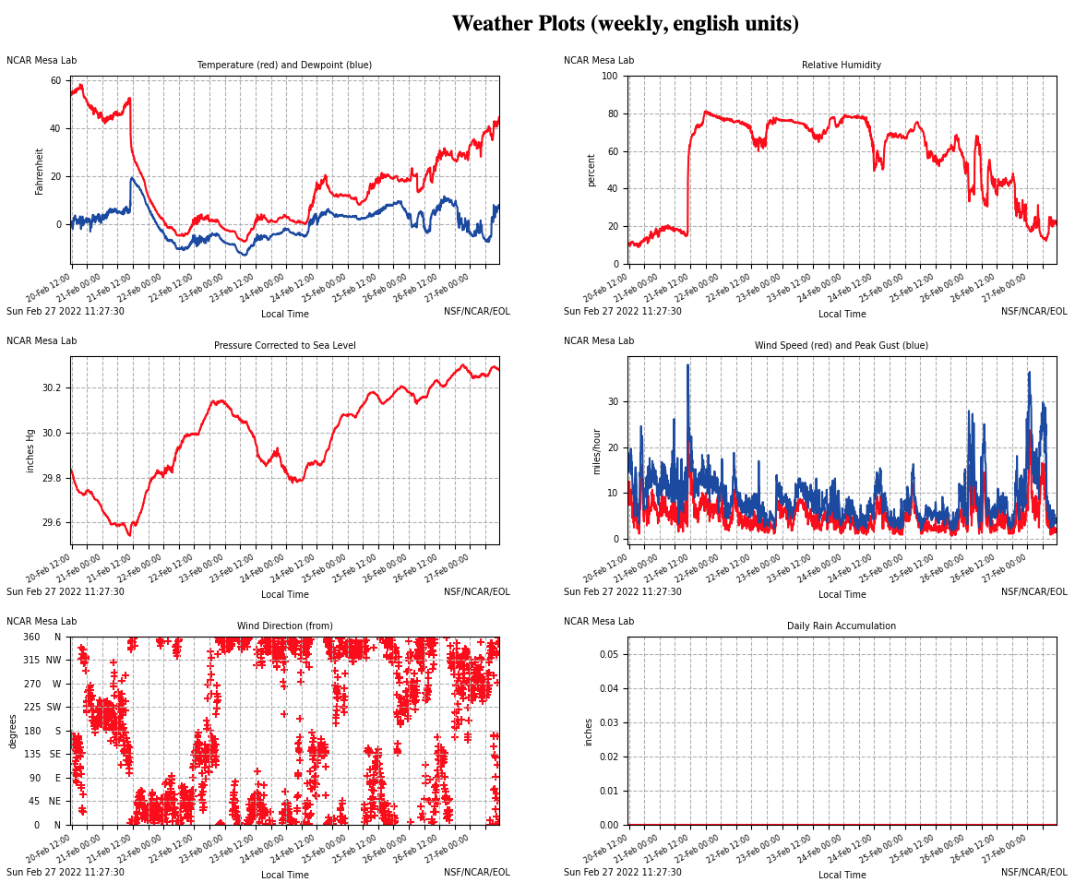
Was Feb. 20-27, 2022 “Winter” or “Spring”??
Notes:
https://archive.eol.ucar.edu/cgi-bin/weather.cgi?site=ml&fields=tdry&fields=rh&fields=cpres0&fields=wspd&fields=wdir&fields=raina&site=ml&units=english&period=weekly

Slide 4
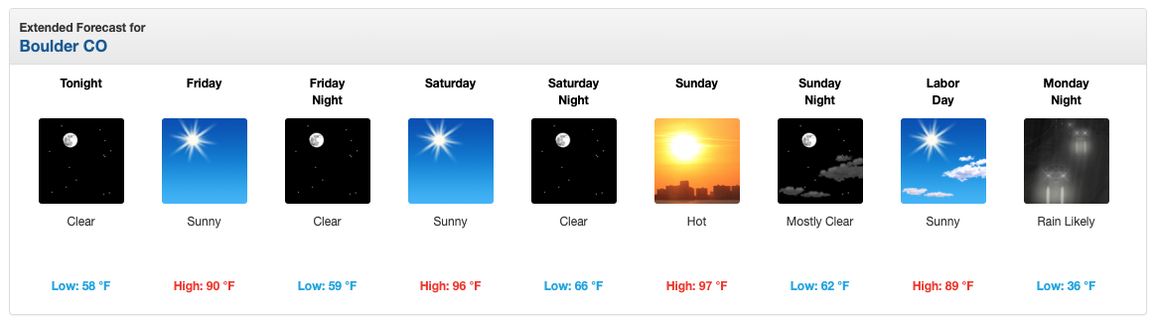
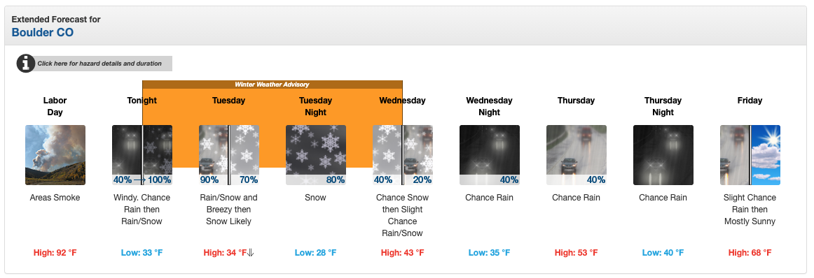
Does “Fall” Exist along the Front Range?
e.g., Boulder weather forecasts for Labor Day 2020…

Slide 5
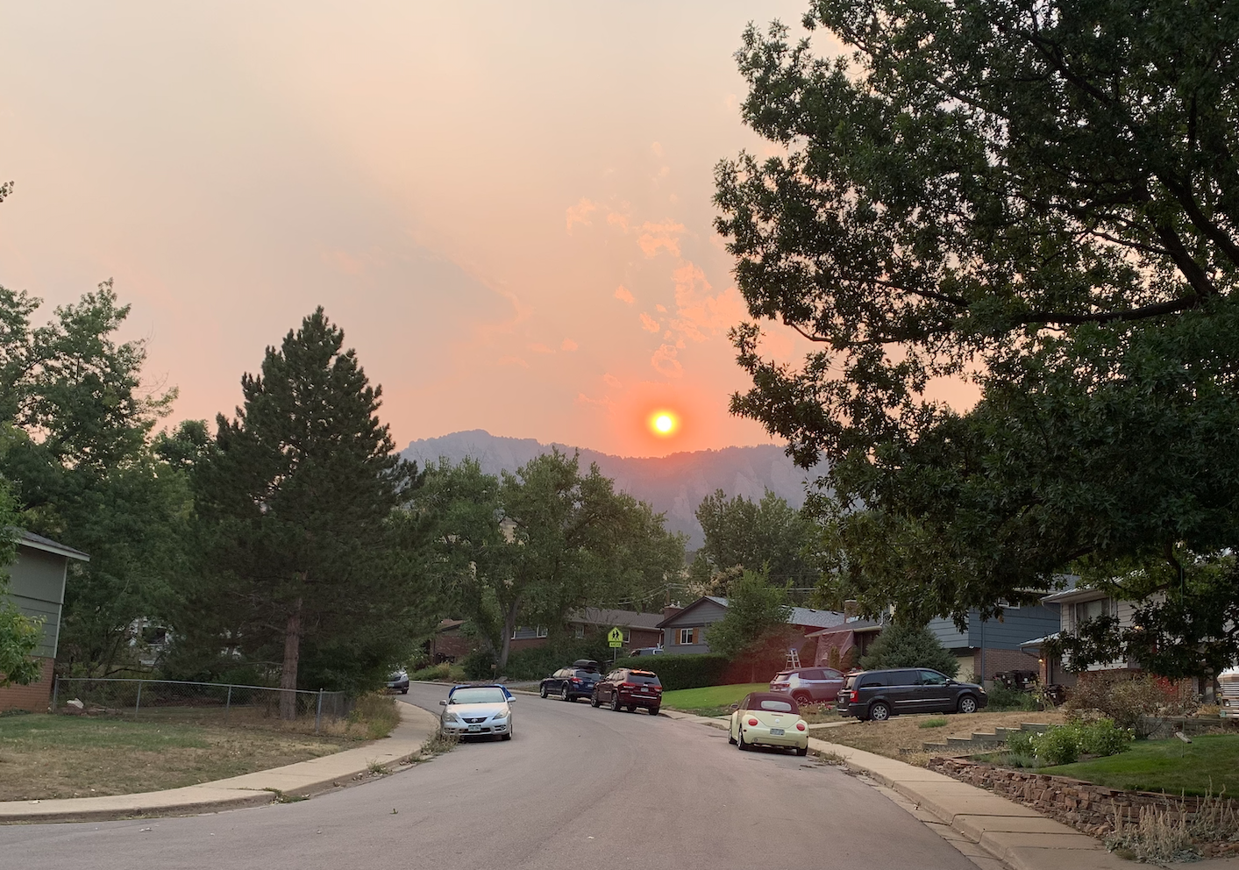
Pictures from September 6, 2020 – High that day 90 F
“summer”?

Slide 6
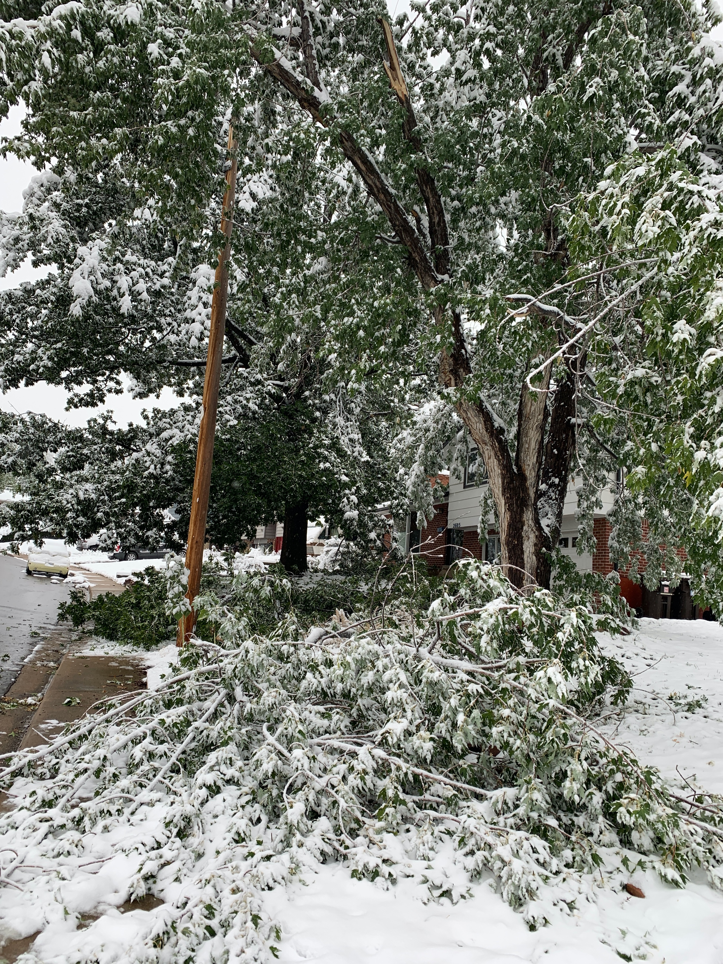
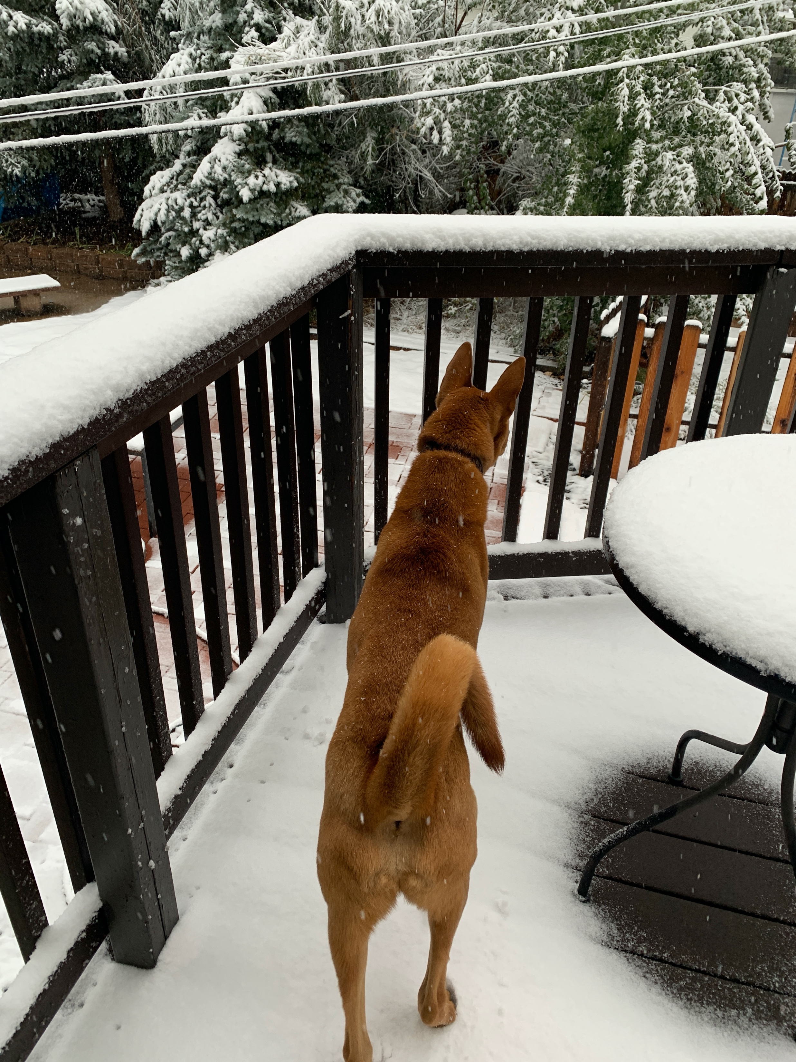
Pictures from September 8-9, 2020
Snow, Lots of Tree Damage
“winter”, “fall”, “spring”?

Slide 7
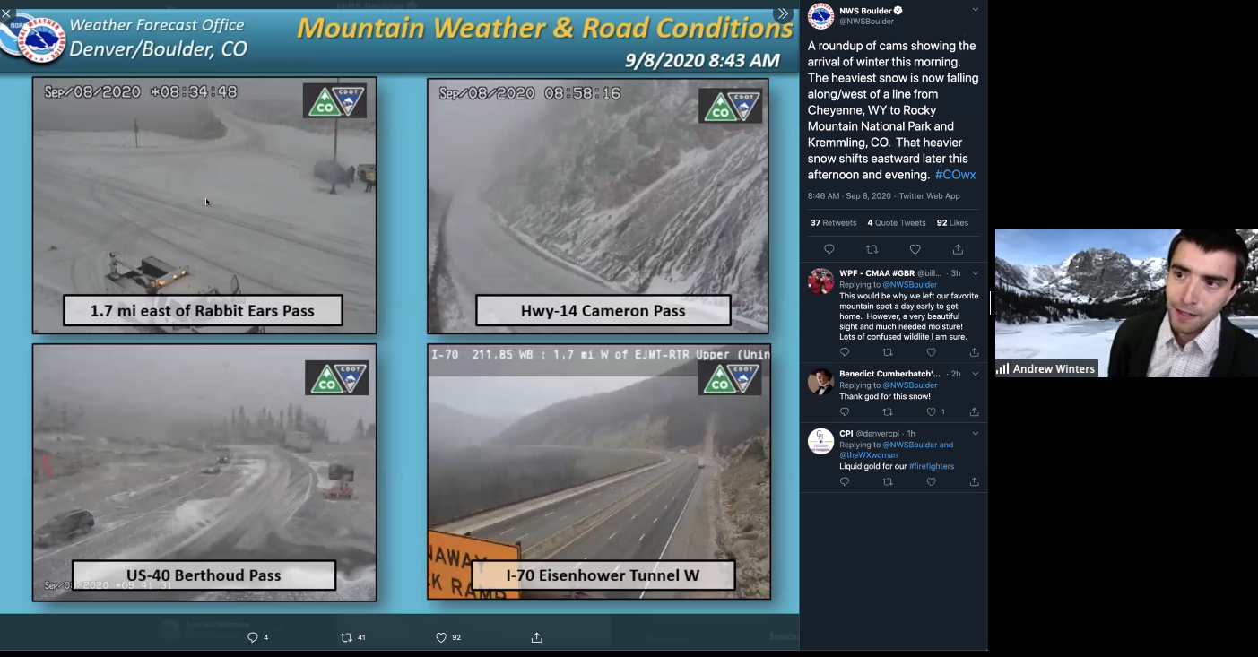
ATOC Weather Discussion
Prof. Andrew Winters (ATOC) gave a special weather discussion
about this crazy Labor Day 2020 weather that I uploaded to Canvas.
More recent discussions are here: https://acwinters.weebly.com/atoc-wx-discussion.html

Slide 8
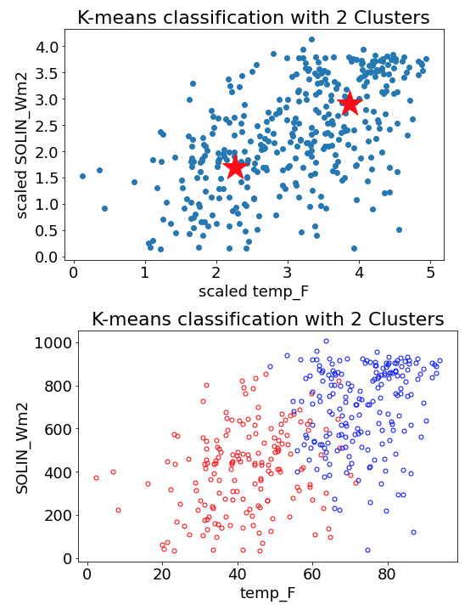
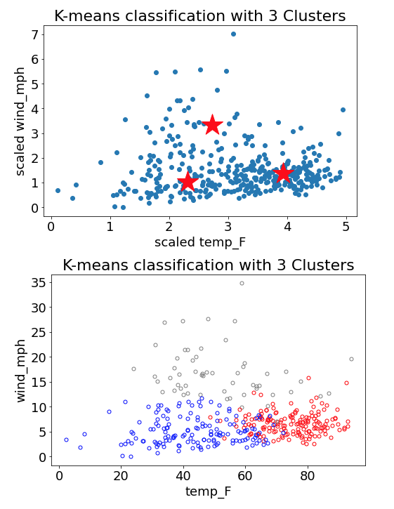
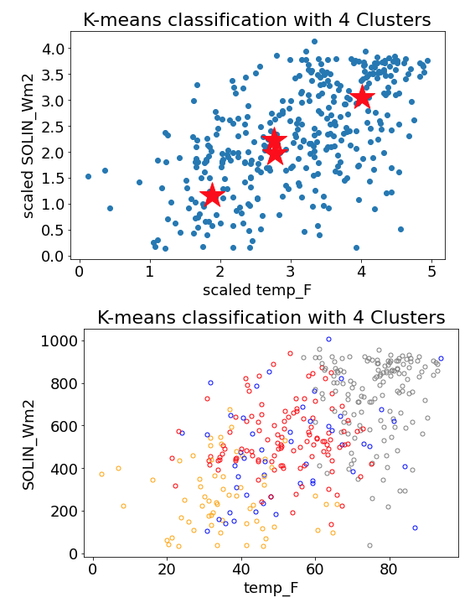
Application Lab #3 – K-means clustering of weather observations: If we cluster the Christman dataset into 4 independent clusters – Does these clusters look like our four date-defined seasons (i.e., winter, spring, summer fall)? How many independent clusters (i.e., seasons) are there in the Christman dataset? How does this number depend on the input data (i.e., time of day, which variables are used)?
cluster1=red, cluster2=blue, cluster3=grey, cluster4=orange

Slide 9
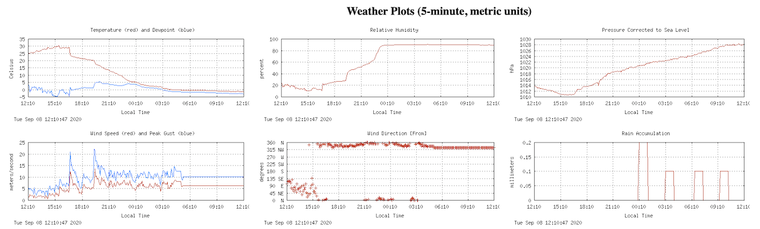
Unsupervised learning example: k-means Cluster Analysis of weather data.
You will doing these calculations in homework #4! ☺
Mesa dataset Variables (7, 2016-2021): Surface pressure, Surface temperature, Relative Humidity, Wind Direction, Wind Speed, Wind Gust, Rain accumulation

Slide 10
Looking forward:
Homework #4 is due next Thursday March 17.
Contact Prof. Kay or Giovanni if you have any questions or concerns. Office hours are on this week:
Giovanni Monday 3-4 pm https://cuboulder.zoom.us/j/96536534549 Passcode: letscode!
Prof. Kay Wednesday 4-6 pm https://cuboulder.zoom.us/j/99769486583 Passcode: help

Slide 11
Assigned Groups Unit #4 - ATOC4500:
Lecture #7, Application Lab #3,
Homework #4
Group #1: Laura, Nate, Ania, Ben
Group #2: Sean, Jackie, Gillian, Alyssa
Group #3: Daphne, Sam, Erica
Group #4: Rachel, Devon, Fergus
Group #5: Victoria, Jacob, Sydney

